Slide 1
Background Subtraction Without the Use of Green or Blue Screens
James Arnold E. Nogra

Slide 2
Background Subtraction
Background subtraction, also known as foreground detection, is a technique in the fields of image processing and computer vision wherein an image's foreground is extracted for further processing (object recognition etc.).
  https://en.wikipedia.org/wiki/Background_subtraction

Slide 3
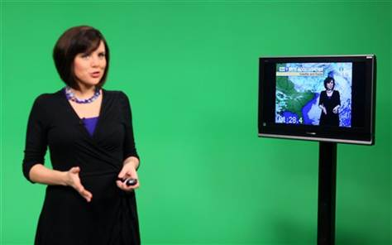

Background Subtraction
http://media2.s-nbcnews.com/j/ap/winter%20weather--1675773381.grid-6x2.jpg
http://news.images.itv.com/image/file/351873/article_update_img.jpg

Slide 4
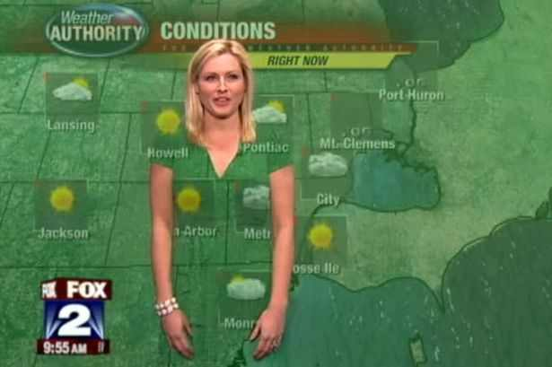
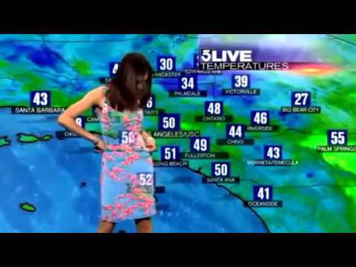
Green/Blue Screen Disadvantages
https://i.ytimg.com/vi/ZmUVNPW5vjY/hqdefault.jpg
http://imgur.com/GoSv2YT

Slide 5
Green/Blue Screen Disadvantages
What if green/blue screen backgrounds is/are not available?
Outdoor setting.

Slide 6
Using Frame Differencing
Frame differencing is a technique where the computer checks the difference between two video frames. If the pixels
have changed there apparently was something changing in the image (moving for example).
  https://www.kasperkamperman.com/blog/computer-vision/computervision-framedifferencing/
If the pixels of the set background and the video feed are almost the same (provided a threshold), then that pixel will be replaced with a predefined image.
If the pixel of the set background and the video feed are very different, then the pixel from the video feed will be used.

Slide 7
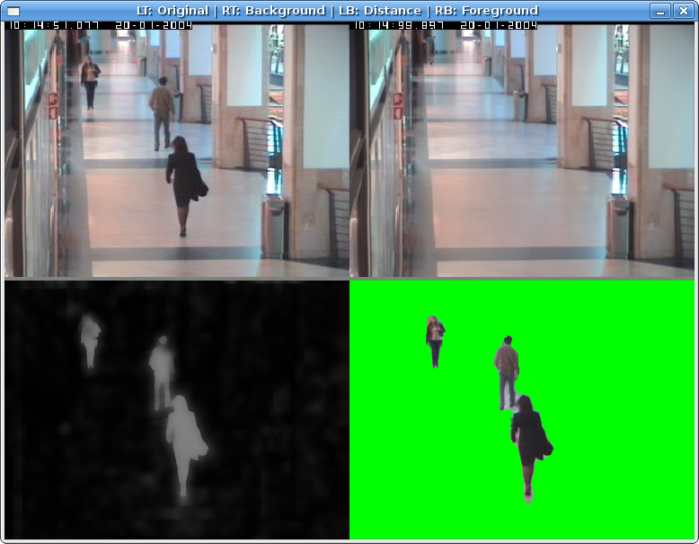
Example
http://www.idiap.ch/~odobez/human-detection/

